Slide 1

INSURANCE CLAIM STATUS

Slide 2
Problem Statement
Title: Predicting Insurance Claim Status
Problem Descriptive:
The current manual process of evaluating insurance claims is time-consuming, prone to errors, and may result in delays in claim processing. There is a need for an automated system that can predict the status of insurance claims based on relevant features and historical data.
Goal/Objective:
The primary goal of this project is to develop a predictive model that can accurately determine the status of insurance claims.

Slide 3
DATASET CONTAINS
Columns contains the values of :
Insurance Type
Premium Amount
Claim Amount
State
Age
Tenure
Employment Status
No. of Family Members
Risk Segmentation
House Type
Customer Education Level
Claim Status
Incident Severity
Authority Contacted
Any Injury
Police Report Available
Incident state

Slide 4

DATA PREPROCESSING:
It refers to the cleaning, transforming, and integrating of data to make it ready for analysis.
Why preprocessing is done:
The goal of data preprocessing is to improve the quality of the data and to make it more suitable for the specific data mining task.
We have done Data Cleaning, Data Transformation and Data Reduction in this model.

Slide 5

DATA CLEANING:
It is the process of fixing or removing incorrect, corrupted, incorrectly formatted, duplicate, or incomplete data within a dataset.
Ignoring tuples (Removing the missing data)
Handlings the missing values
Dealing with duplicates
Removing Unwanted Data
DATA TRANSFORMATION:
It is the process of converting, cleansing, and structuring data into a usable format that can be analyzed to support decision making processes.
Performed Encoding
Changed the datatypes
Removing Outliers
DATA REDUCTION:
It is a capacity optimization technique in which data is reduced to its simplest possible form to free up capacity on a storage device
Random over samplings

Slide 6
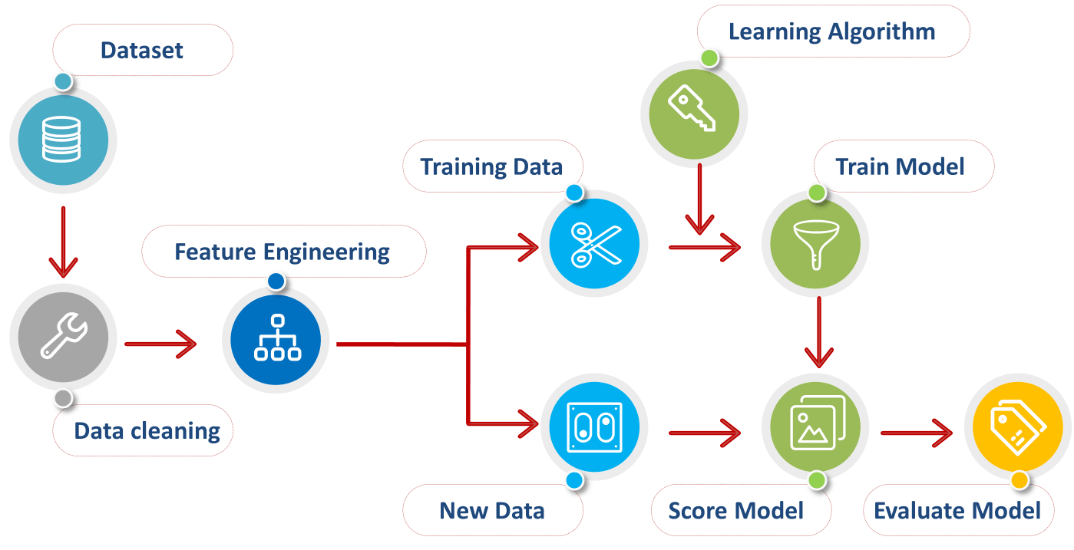

Slide 7

MODEL SELECTION
The process of selecting the best algorithm and model architecture for a specific job or dataset. It entails assessing and contrasting various models to identify the one that best fits the data & produces the best results.

Slide 8
Different types of Classification Models are:
Logistic Regression
Decision Tree
Support Vector
Gaussian Naïve Bayes
Random Forest
Extra Tree
KNN
In this Case, Random Forest is better algorithm.

Slide 9
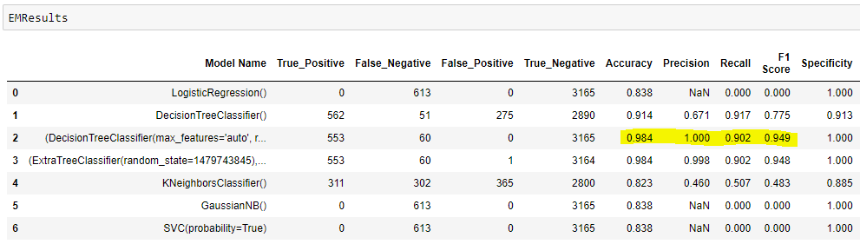

Slide 10
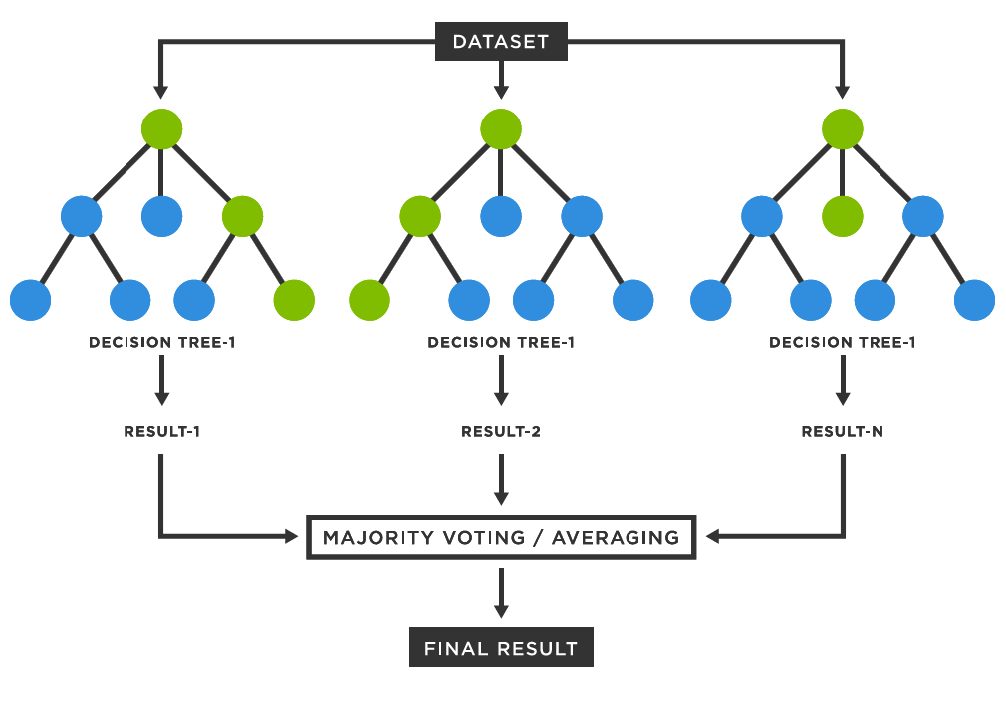
Random Forest Classification:
Random Forest is an ensemble learning method that combines the predictions of multiple individual models, known as decision trees, to improve overall predictive accuracy and control overfitting.
It is capable of handling large datasets with high dimensionality.
It enhances the accuracy of the model and prevents the overfitting issue.

Slide 11
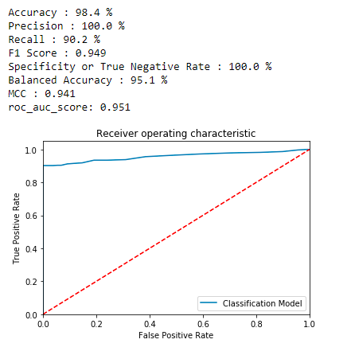

Slide 12
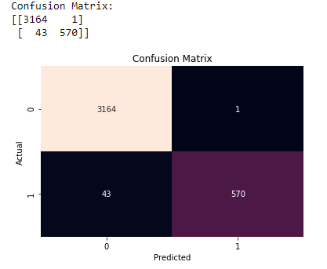

Slide 13
Thank You

